Slide 1
MSEG610 Experimental Mechanics of Composites
Lab 1: Panel Lay-up and Quality Testing
Zachary Swain
Group Members
Chunyan Zhang
Evan Minnigh
Jerome Premkumar
Casey Busch
Lab Dates: Feb. 22, 27 2019
Date Submitted: March 8 2019

Slide 2
Outline
Abstract
Objective and Result Summary
Procedure
Materials
Instrumentation
Fabrication
Evaluation
→ Analysis
Results
Conclusions and References

Slide 3
Abstract
Objectives:
Lay-up, process and fabricate laminate as specified below
[0/90]_{2S} ^{[1]}
Utilize non-destructive evaluation techniques to inspect and analyze laminate quality
Summary of Results
The panel is determined to have a fiber volume fraction of 55.9% and a void volume fraction of 0.32%

Slide 4
Procedure
Nomenclature in terming laminate lay-up is to follow ASTM D6507.^{[1]}
The prepreg used was of Toray T700S fiber.^{[2]} T700S Data:
T700S Data:
Toray T700S
Fiber Properties |  |  | Functional Properties |  |  | Composite Properties
Tensile Strength | 711 ksi | TY-030B-01 | CTE | .-0.38 α⋅10⁻⁶/°C |  | Tensile Strength | 370 ksi |  | ASTM D-3039
Tensile Modulus | 33.4 Msi | TY-030B-01 | Specific Heat | 0.18 Cal/g⋅˚C |  | Tensile Modulus | 20.0 Msi |  | ASTM D-3039
Strain | 2.1 %. | TY-030B-01 | TC | 0.0224 Cal/cm⋅s⋅˚C |  | Tensile Strain | 1.7%. |  | ASTM D-3039
Density | .065 lbs/in³ | TY-030B-02 | Electric Resistivity | 1.6 x 10⁻³ Ω⋅cm |  | Compressive Strength | 215 ksi |  | ASTM D-695
Filament Diameter | 2.8E-4 in. |  | Composition | Carbon = 93% |  | Flexural Strength | 245 ksi |  | ASTM D-790
 |  |  |  | Na + K = <50ppm |  | Flexural Modulus | 17.5 Msi |  | ASTM D-790
 |  |  |  |  |  | ILSS | 13 ksi |  | ASTM D-2344
 |  |  |  |  |  | 90˚ Tensile Strength | 10.0 ksi |  | ASTM D-3039

Slide 5
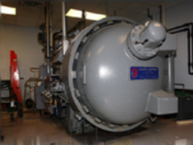
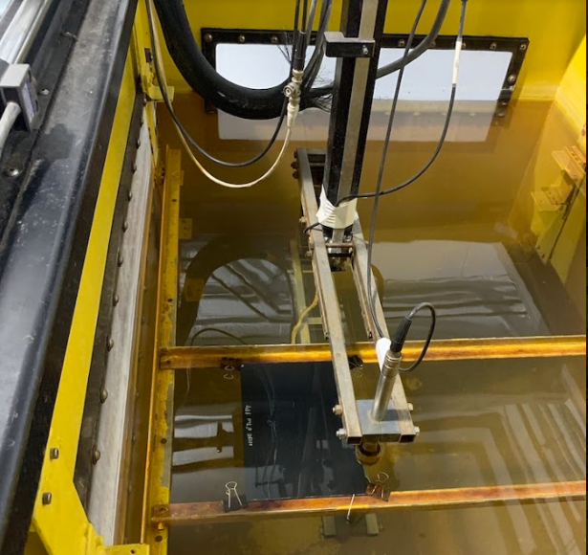
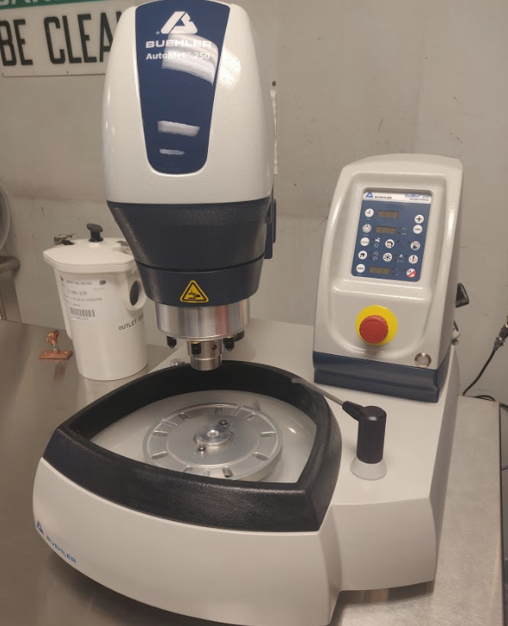
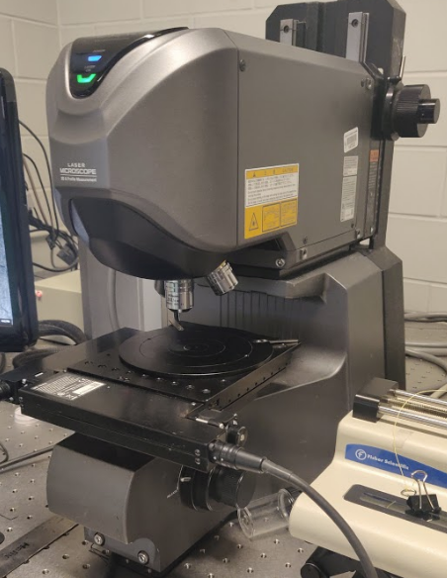

Instrumentation
A TEC Processing Autoclave, Matec Four-Axis Ultrasonic Scanner, Buehler AutoMet 250 Grinder-Polisher, Keyence VK-X200 confocal microscope, and SMARTree software suite were used in laminate processing and quality analysis. These are imaged respectively in Fig. 1.
Fig. 1

Slide 6
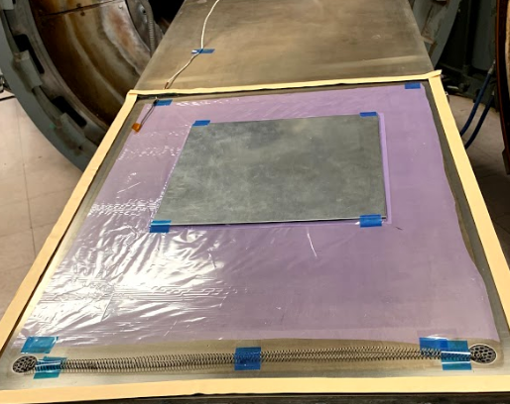
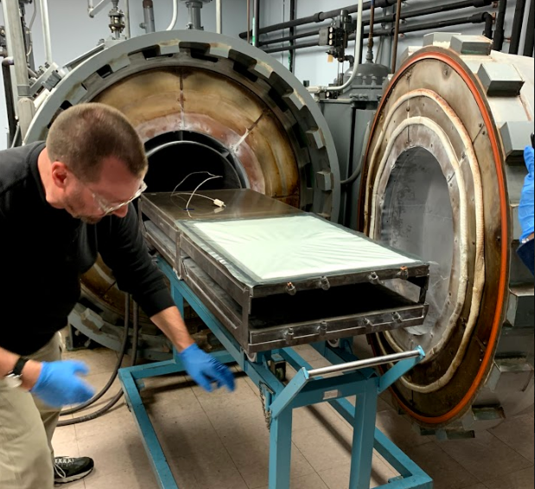
Fabrication
8 sheets of Toray T700S prepreg were provided pre-cut, warmed, and
treated. Each sheet was placed upon the prior layer with a perpendicular fiber
direction, until the mid-plane was reached. The top 4 layers were then placed
to mirror the bottom 4-layers across the mid-plane, as to ensure balanced
properties and quality of fabrication. Each layer was pressed in place with a
roller to press out any potential air pockets and apply pressure to adhere to the
previous layer.
The surface of the table was prepared with Frekote 55-NC prior to setup.
A bottom film was taped onto the surface, minding a uniformly smooth surface.
The 8 layer panel was placed on top of the film, near center, and likewise taped
down. Next, a spring was inserted to connect the vacuum line and the vacuum
transducer to maintain an open channel between the two. A perimeter of tape
was placed around the edge of the table surface and a thermocouple was placed
inside its boundary (Fig. 2). Finally, peel ply and fiber foam sheets were both
placed onto the panel, promoting uniform geometry and processing conditions,
and also allowing a breather layer. The vacuum bag was then placed onto the
tape and roller to ensure consistent adherence to the tape perimeter.
Fig. 2
Fig. 3

Slide 7
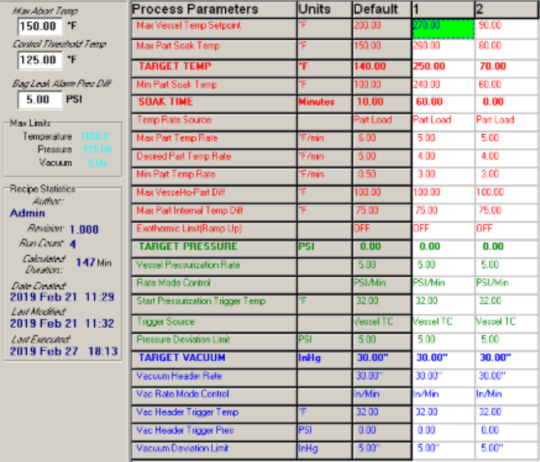
Fabrication
Vacuum, transducer, and thermocouple lines were all connected next. Vacuum was pulled under the bag, and was monitored to determine if there were any in the bag’s seal. After pressing out kinks in the bag-tape contact, the table was rolled into to autoclave to begin its cycle (Fig. 3).
Fig. 4 displays the autoclave process parameter recipe used to run the curing cycle in the autoclave.
Fig. 4

Slide 8
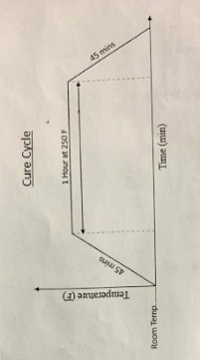
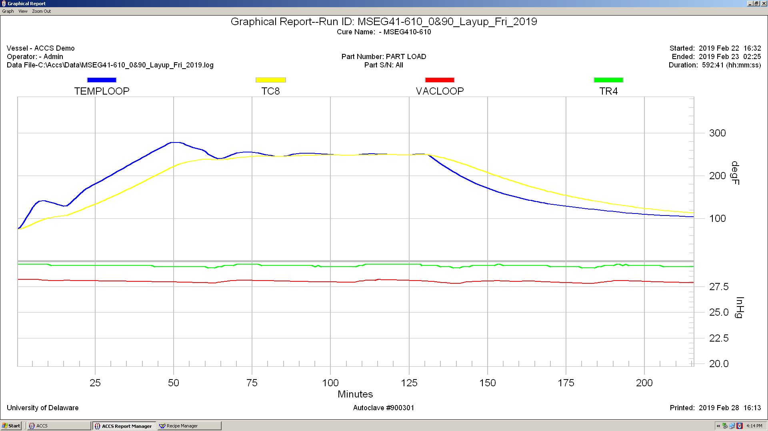
Fabrication
In Fig. 5 you can see the provided autoclave cure cycle as well as the actual one measured. Over a timeframe of 45 minutes, the panel was to be ramped up to a 250°soak held for 1 hour. The data from the actual run is given by “TC8” as the thermocouple reading for monitoring panel temperature, and “TR4” as vacuum transducer readout.
As shown in Fig. 5, the panel can be seen to have effectively cured.
Fig. 5

Slide 9
Evaluation
Non-destructive evaluation techniques were used to inspect and analyze laminate quality. These included C-scan and confocal microscopy with SMARTree image analysis.
The C-scanner imaged the panel using transmission of ultrasonic sound waves sent through the specimen and received by a transducer. Variation in signal seen by the transducer from the uniform source indicate local abnormalities in the panel. This can be due to variations in density such as thickness fiber volume fraction, or lay-up imperfections (air pockets/foreign substance). SMARTree was also used to analyze the C-scan results and can be seen in Fig. 6 and Fig. 7. While there are identifiable abnormalities in the specimen, it was decided that it would still suffice just for the purposes of our laboratory testing.

Slide 10
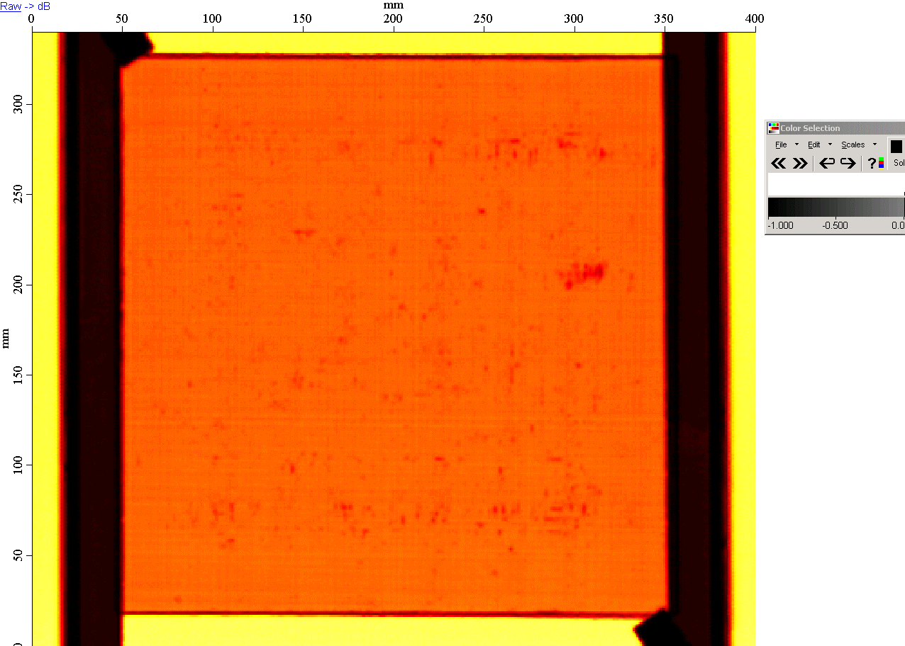
C-scan Results
Fig. 6

Slide 11
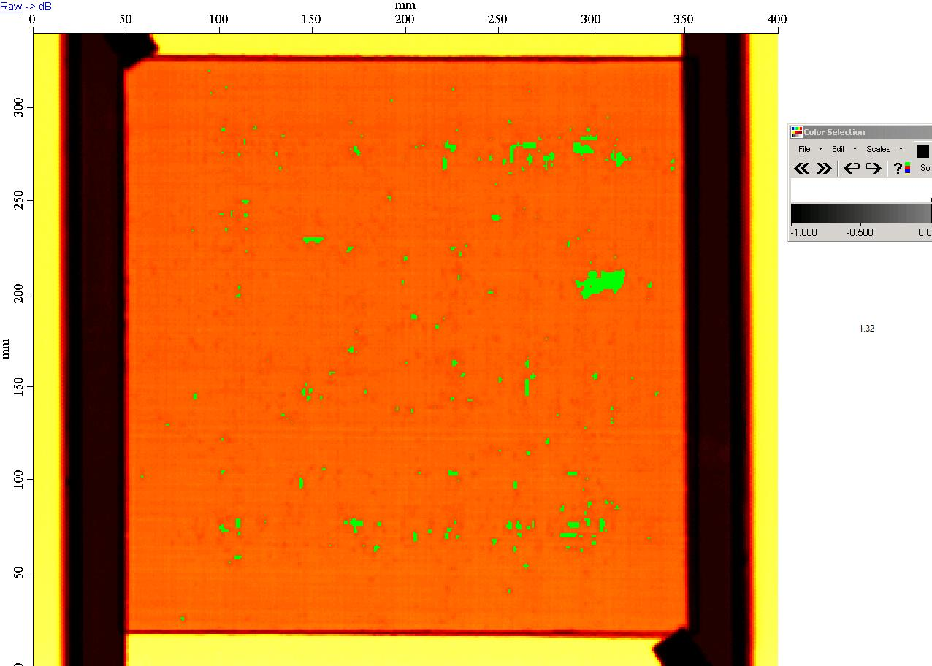
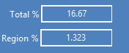
C-scan Results - SMARTree
Important to note going forward for subsequent lab testing; certainly may influence tensile response etc.
Fig. 7

Slide 12
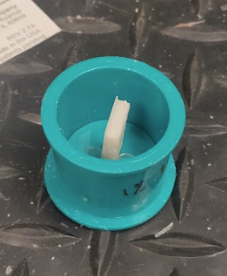
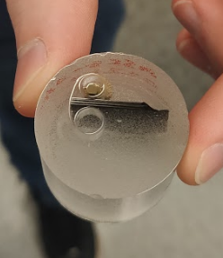
Sample Prep
Next, a small section of the panel was machined from the specimen to prepare for microscopy analysis. This machined sample was then placed into a holder to produce a cross-section as demonstrated in Fig. 8, and encased in resin. The hardened, resin-encased sample is shown in Fig. 9.
Fig. 8
Fig. 9

Slide 13
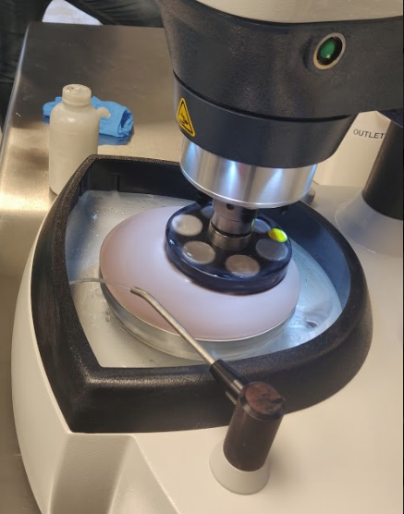
Sample Prep
The hardened sample was then loaded into the Buehler AutoMet 250 Grinder-Polisher to begin wet sanding and polishing. The sample was incrementally sanded and then polished using solution of Aluminum Oxide particles of known size, incrementing the size of the abrasive smaller and smaller to achieve a cleaner surface. This process is pictured in Fig. 10.
Fig. 10

Slide 14
Microscopy
After the sample was suitably polished, it was imaged under a Keyence VK-X200 confocal laser microscope. The polished sample cross-section was imaged at 20x and 50x magnification. These images are shown in Fig. 11 and 12, respectively.
SMARTee software suite was utilized for image analysis on both images to determine the fiber volume fraction of the panel. It is important to note that since it is a [0/90]_{2S} panel, only the layers that have been machined orthogonal to their fiber orientation can be analyzed for fiber volume fraction. SMARTree image analysis for a quick, approximate FVF and void fraction are displayed in Fig. 13 and Fig. 14, respectively.

Slide 15
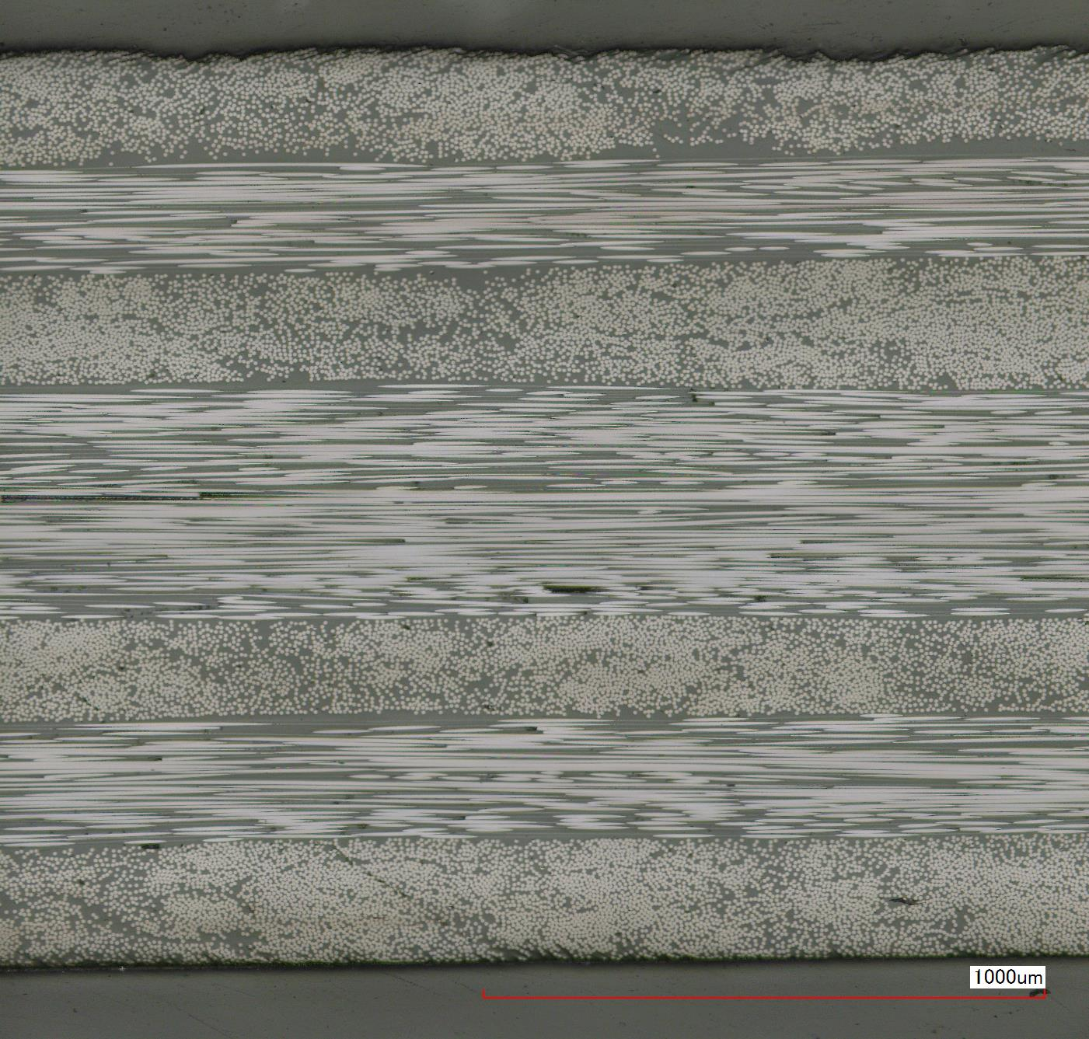
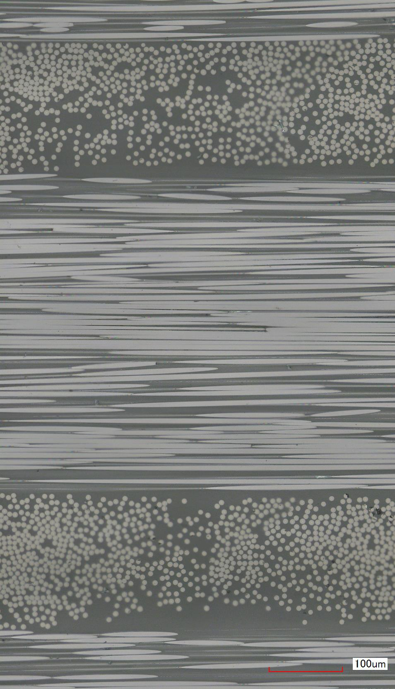
Microscopy
Fig. 11
Fig. 12

Slide 16
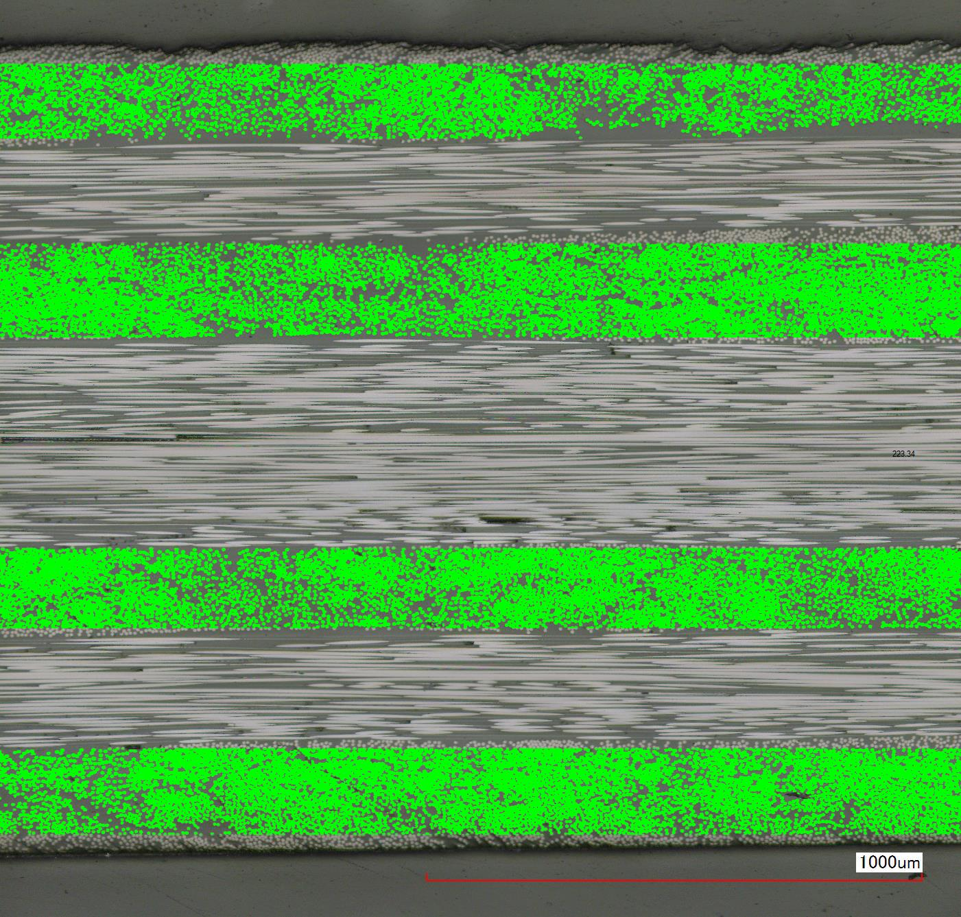

Results
(SMARTree 20x)
/4 regions ≈ 55.8% FVF
Fig. 13

Slide 17
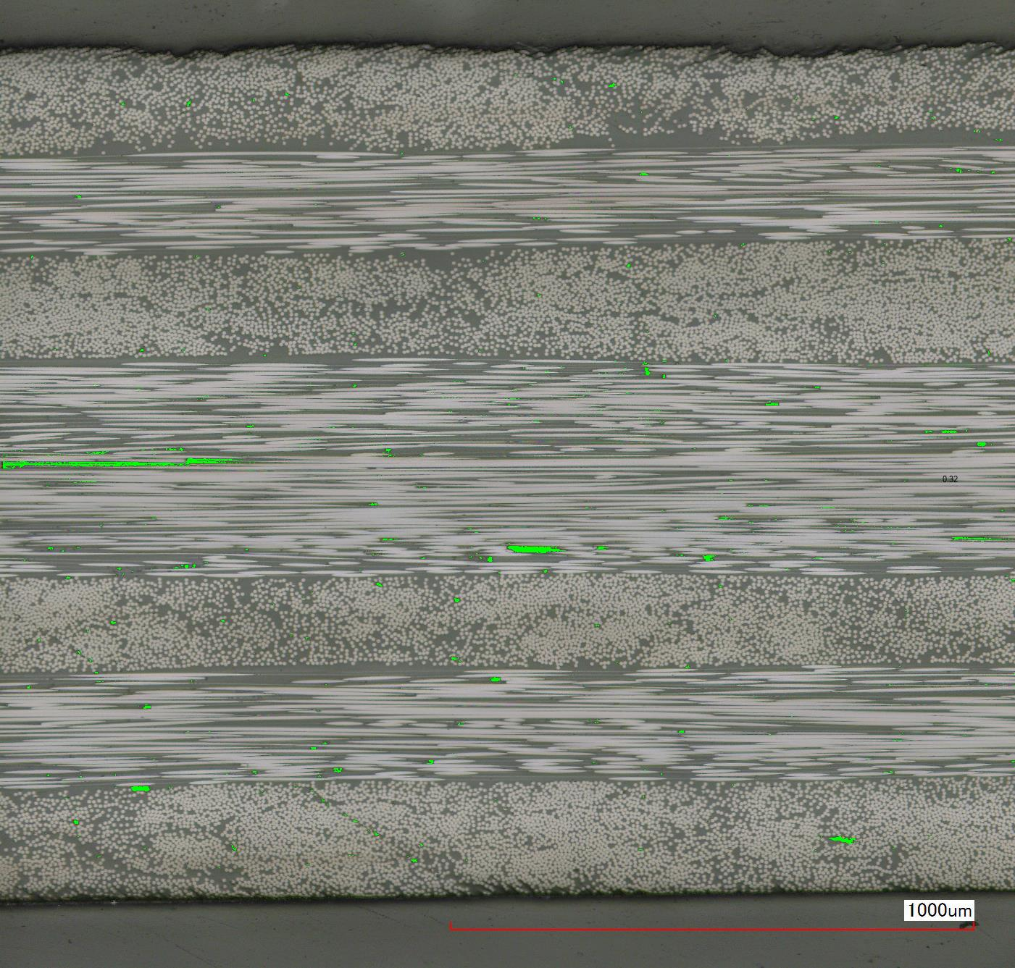
SMARTree 20x – Void Fraction
Fig. 14

Slide 18
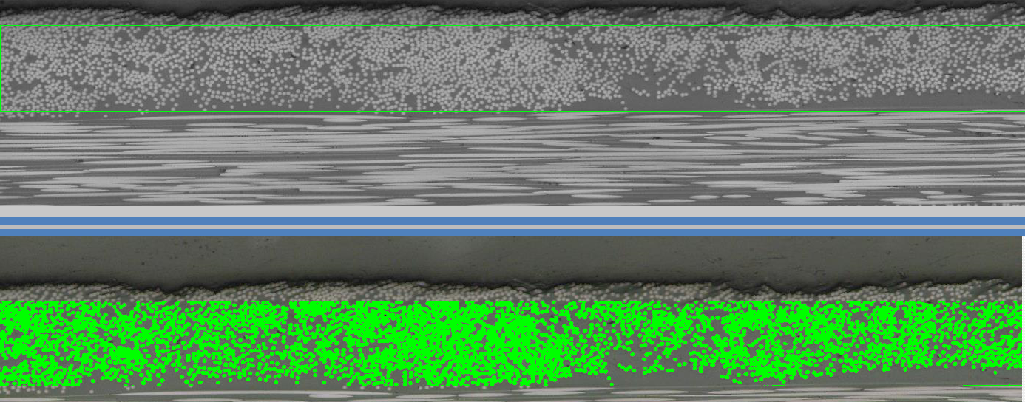
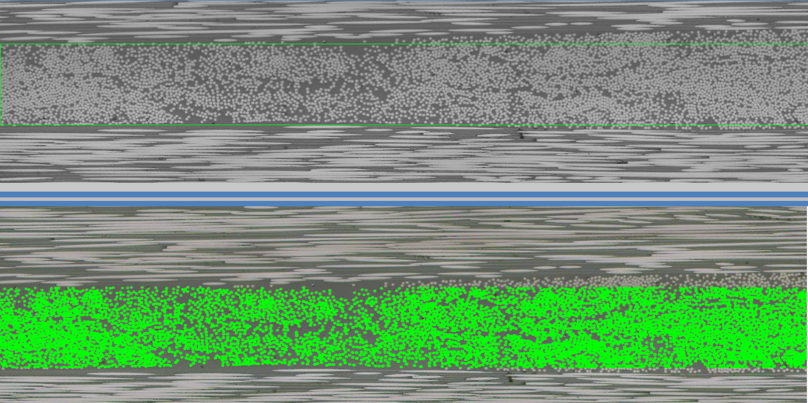


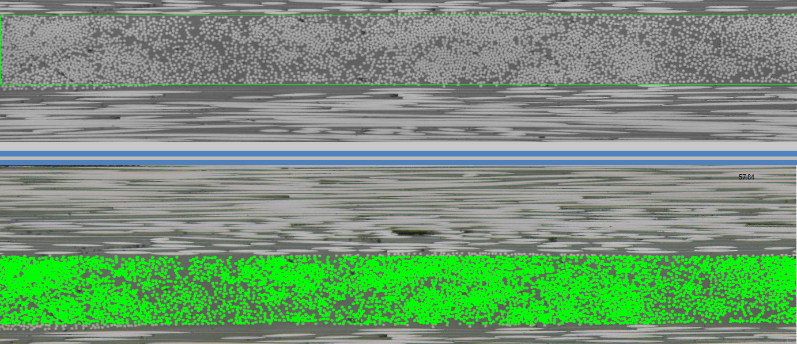
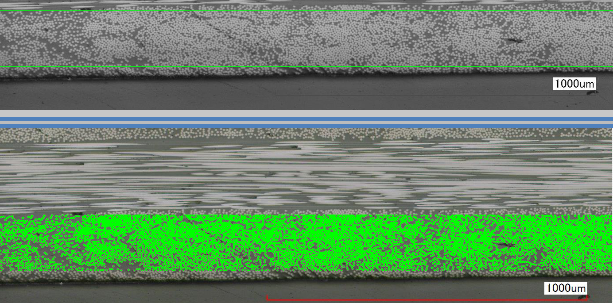


SMARTree 20x – FVF by Layer
Legend
Fig. 15: Top layer
Fig. 16: 2nd from top
Fig. 17: 2nd from bottom
Fig. 18: Bottom layer
Fig. 15
Fig. 16
Fig. 17
Fig. 18

Slide 19
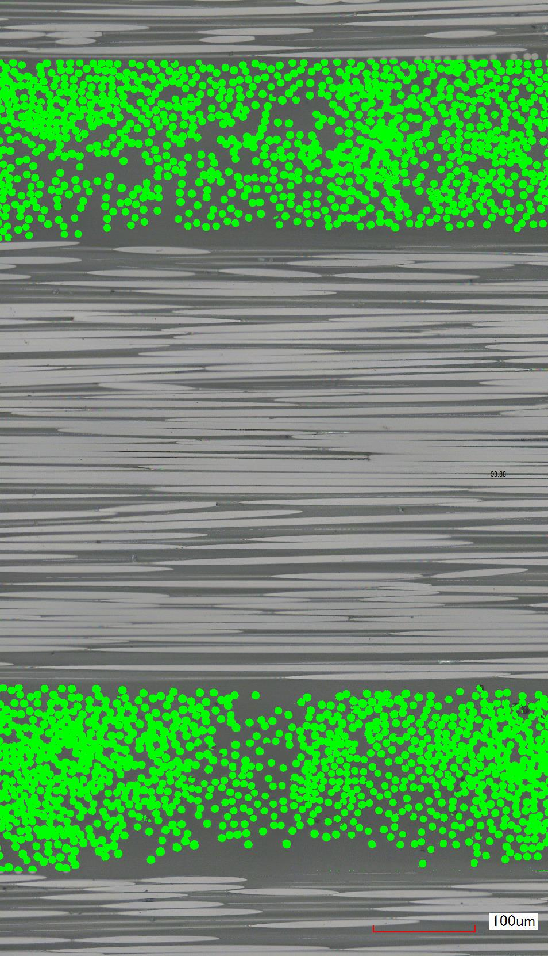

SMARTree 50x – Fiber fraction
/2 regions ≈ 46.94%
Fig. 19
Fig. 20

Slide 20
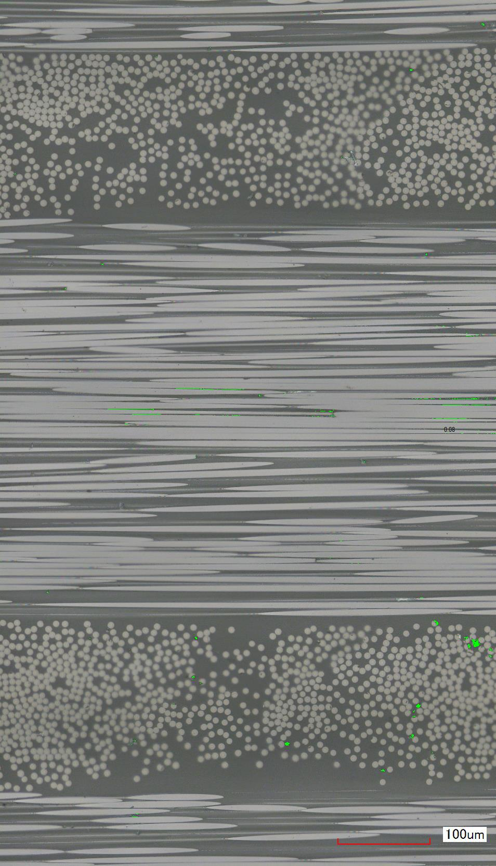

SMARTree 50x –
Void Fraction
Fig. 21

Slide 21
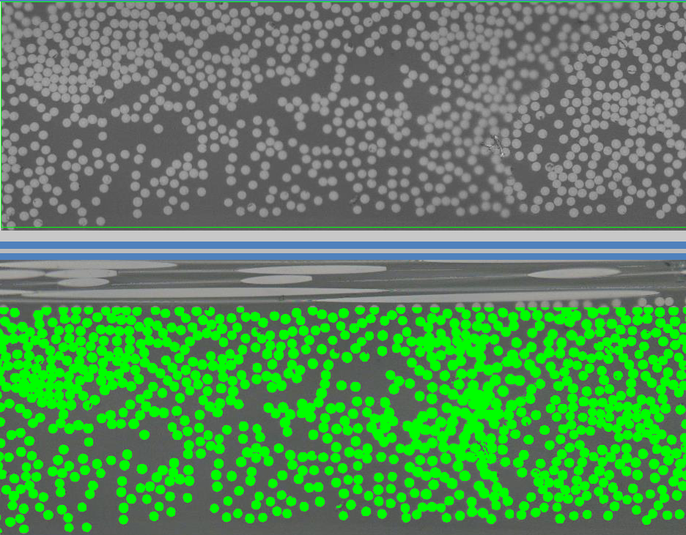
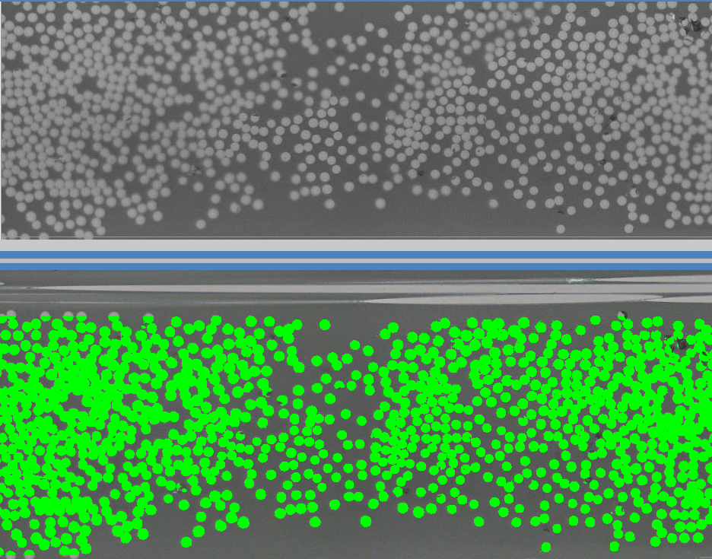

SMARTree – FVF by Layer
(50x)
Legend
Fig. 15: Upper layer
Fig. 16: Lower layer
Fig. 22
Fig. 23

Slide 22
Analysis
In Figs. 15-18, each layer that has been cut, polished, and imaged (at 20x magnification) orthogonal to the fiber orientation is analyzed in SMARTree. Layers are found to have 54.24%, 56.69%, 57.84%, and 54.81% FVF, respectively from top layer to bottom layer. This gives an average FVF of 55.9% with a standard deviation of 1.67%. The sample is also found to have ~0.32% void fraction over the 20x imaged sample.
In Figs. 22 and 23, both of the relevant 50x magnified layers are imaged and analyzed. The upper layer is found to have 45.67% FVF, with the bottom at 47.4%. The average of these is 46.5 %, while the standard deviation of these two numbers is 1.22% (but is not as relevant). Void fraction is found to be 0.084%

Slide 23
Conclusions
It is ultimately determined that the sample has a fiber volume fraction of 55.9% ±1.67%, and a void volume fraction of .32%. These conclusions are both drawn from the 20x magnified sample image, as it is determined that the 50x sample only provides outliers on previously examined data. The 50x is a much closer image to the surface, and provides a smaller sample size of relevant layers, which also provide data that is less general to the panel. It is analyzing too small of a subsection of the panel to garner holding much weight. Both the FVF and the VF are artificially low because of this.
It is important to note that the volume fractions presented here are certainly approximations, as only the area fractions are found. These have been generalized to their respective volume fractions.
From the piece sampled from the panel, it is found that this specimen is suitable for testing, with a void volume fraction < 1%.

Slide 24
References
[1] ASTM Standard D6507, 2016, “Standard Practice for Fiber Reinforcement Orientation Codes for Composite Materials,” ASTM International, West Conshohocken, PA, 2003, DOI: 10.1520/D6507-16, www.astm.org/Standards/D6507.htm.
[2] T700S Data Sheet [PDF]. Santa Ana, CA: Toray Carbon Fibers America Inc. https://www.toraycma.com/file_viewer.php?id=4459.

